Slide 1

Kitten Factory: Ski Manufacturing
Group 1: Luke Coffman, Jaxon Driver, Emma Lare

Slide 2
Objectives
Kitten Factory’s objective is to manufacture and sell their custom made carbon fiber skis. The products produced by Kitten Factory are made to be lighter weight so that customers can go on a wide variety of terrain, including park, powder, and touring. Along with skis, we sell general merchandise, boots, and bindings, that way our customers get everything they need in one place.

Slide 3
Ethics and Critical Thinking
Secure customers personal credit card information
Make our UI easy to use
Make sure our web application is easy to navigate so customers don’t make harmful mistakes
Work together to get ideas and to make corrections
Think about different ways to use the codes we learned to build our application

Slide 4
Roles
Admin
Username: bsmith
Password: mysecret
Employee
Username: coh
Password: bestprof
Customer
Username: pjones
Password: acrobat

Slide 5

Security
1.Authentication/Login (including password verify and sanitization)
2. Session management (including check session)
3. Logout and session destroy

Slide 6
Database Overview
Orders
Employee
Product
User
Payment
Return
Raw Material
Customer
Orderline
Ordertable

Slide 7
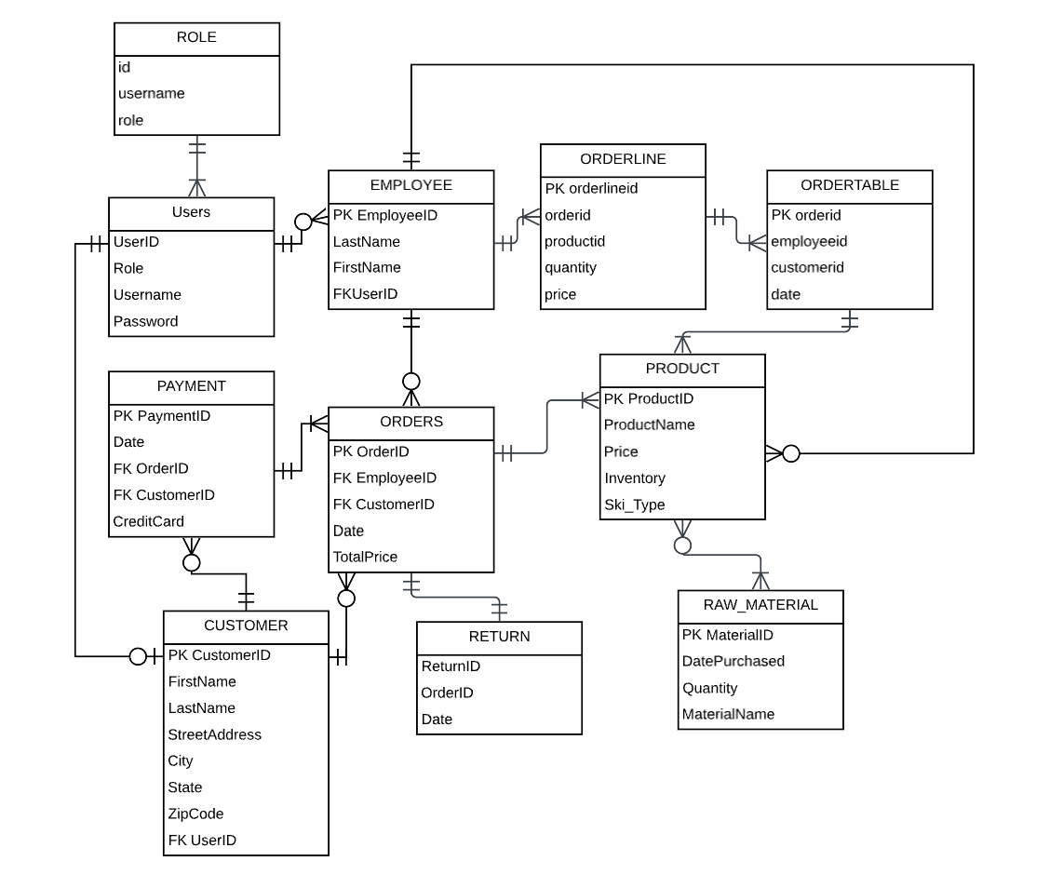

Slide 8
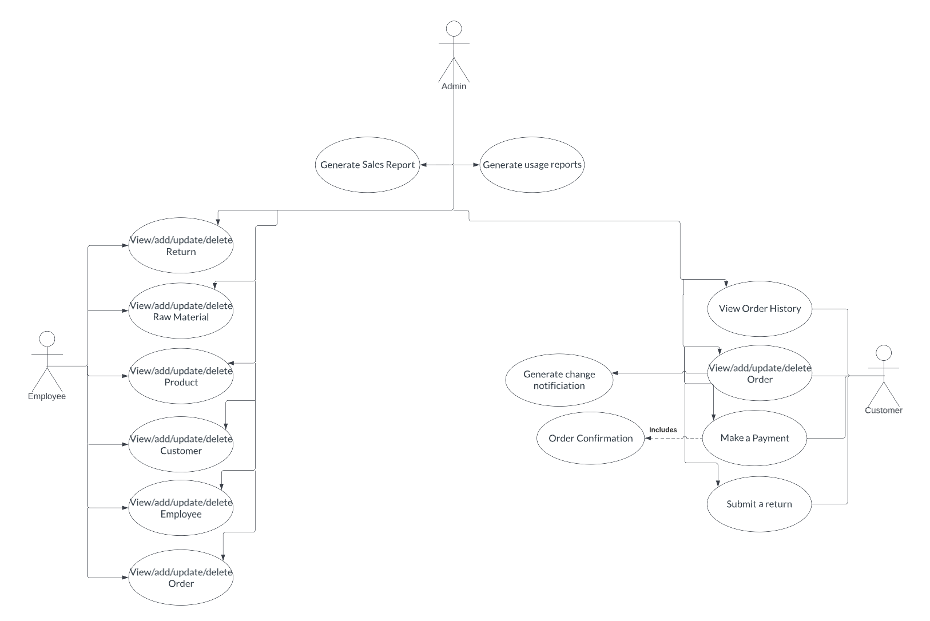

Slide 9
CRUD Use Case Overview
Individual Login Pages Per Role
View/add/update/delete Returns
View Raw Materials
View/add/update/delete Products
View/add/update/delete Customers
View/add/update/delete a new Employee
View/add/update/delete Order
Generate Sales Report
Customer can view/add/update/delete an order
Make a Payment
Submit a return

Slide 10
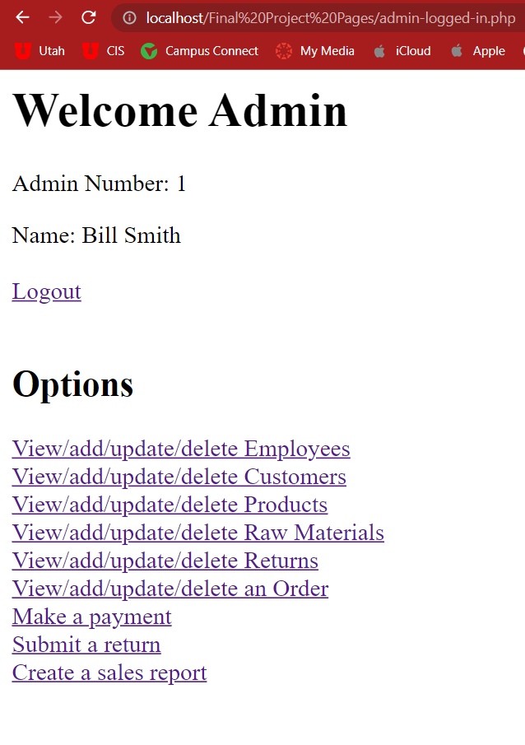
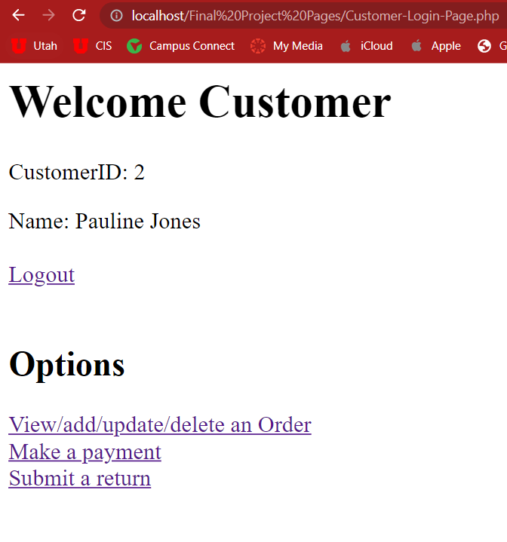
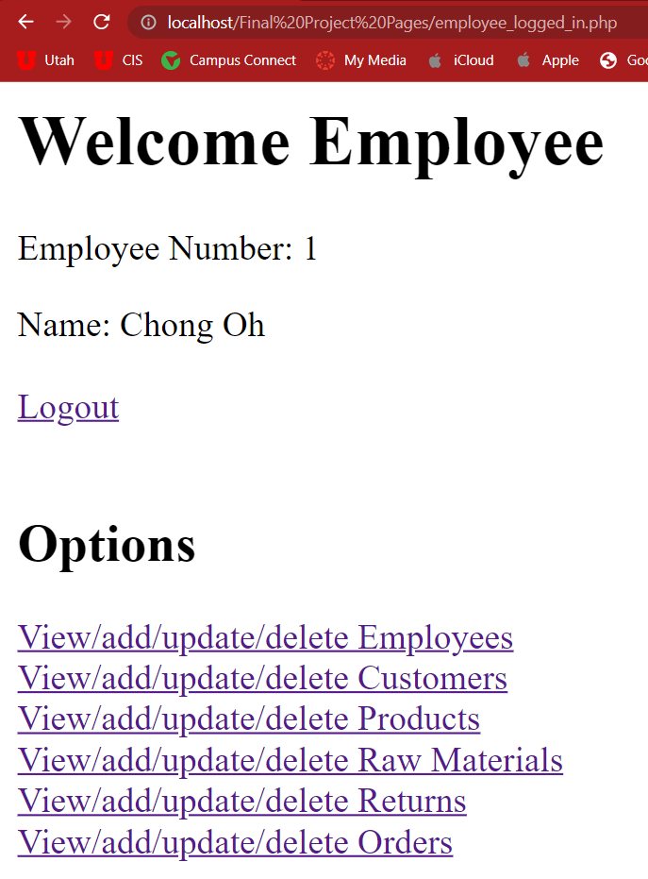
Admin/Employee/ Customer Login

Slide 11
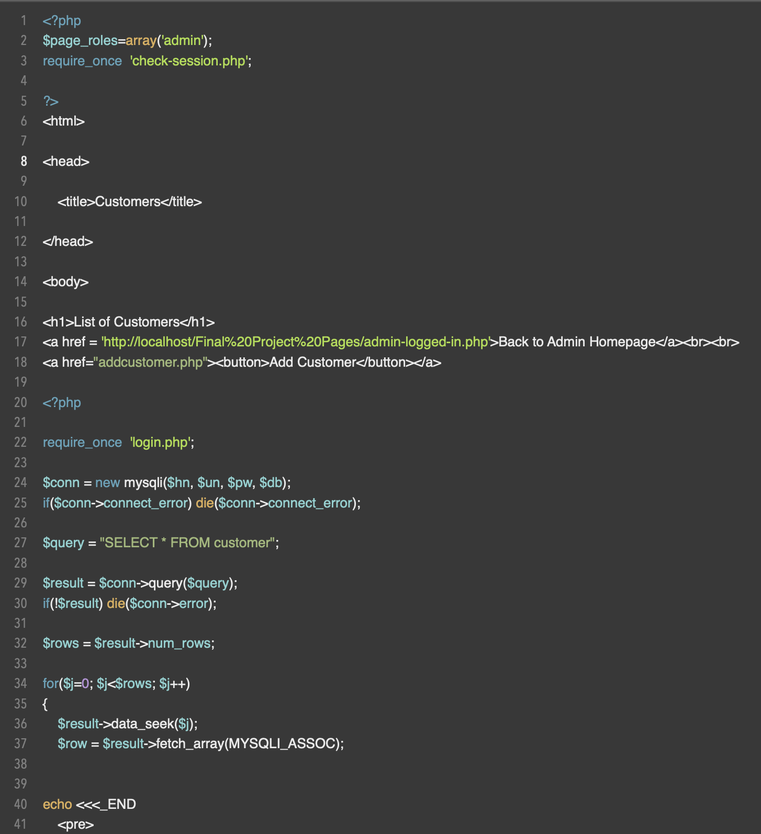
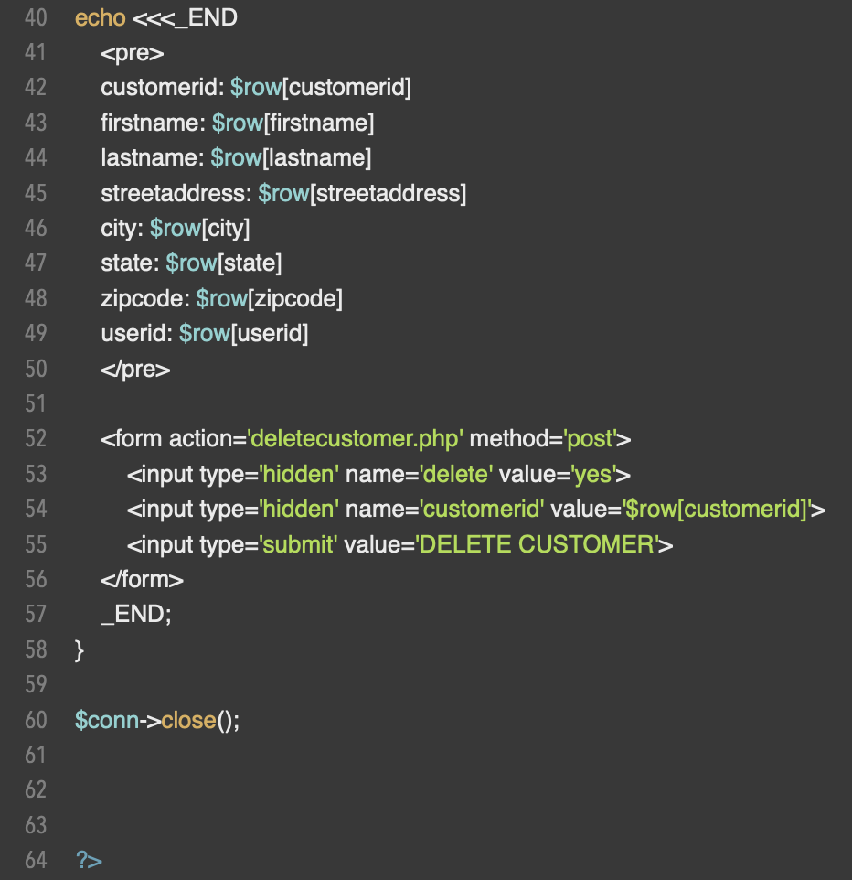
View/Add/Update/Delete Customers Code

Slide 12
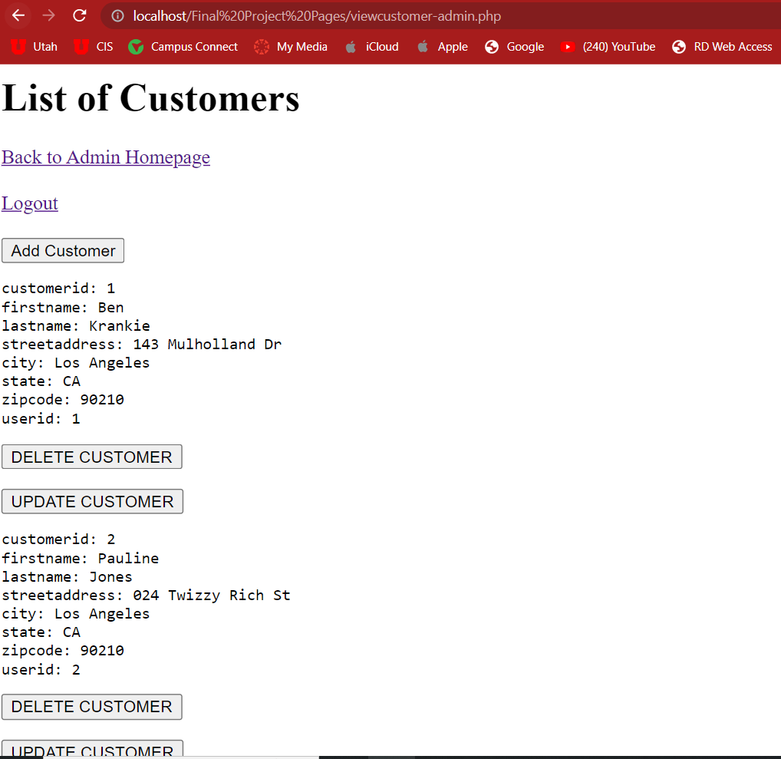
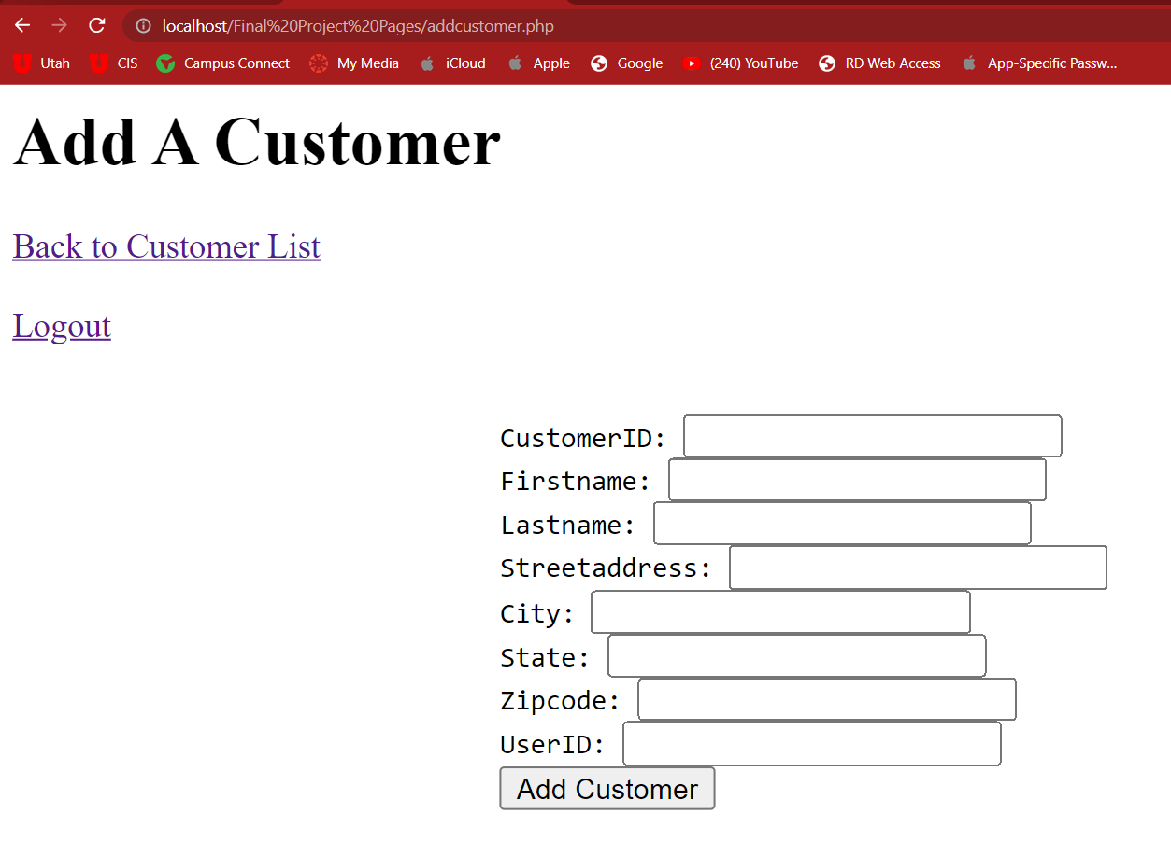
View/Add/Update/Delete Customers Website

Slide 13
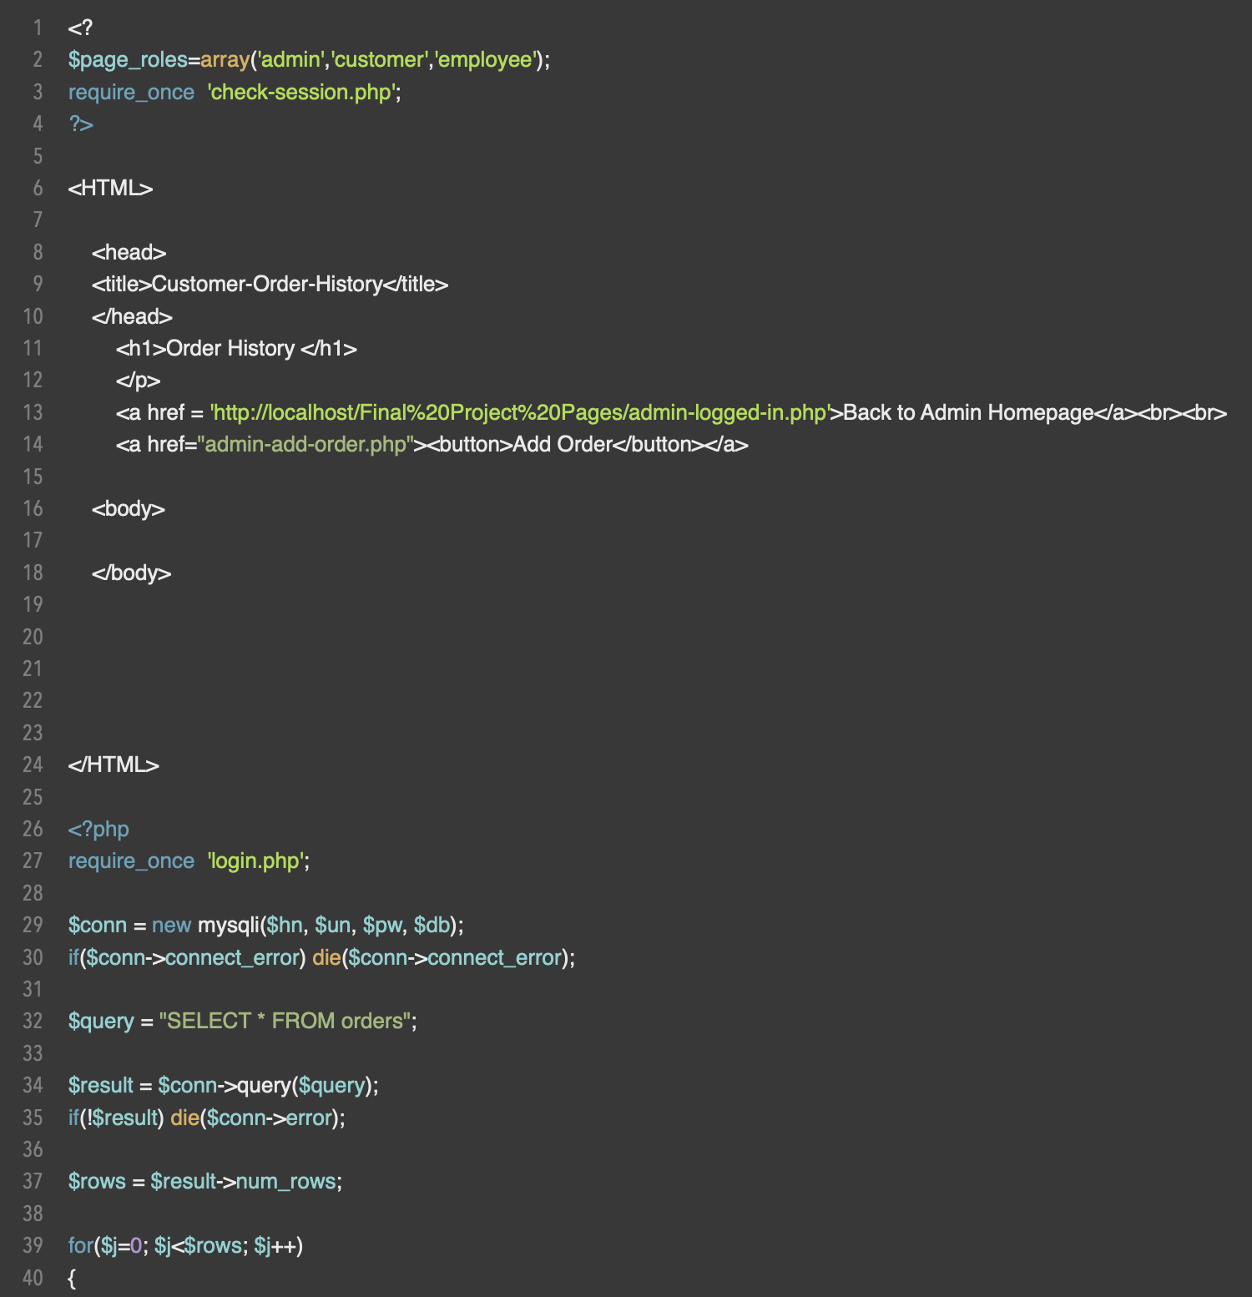
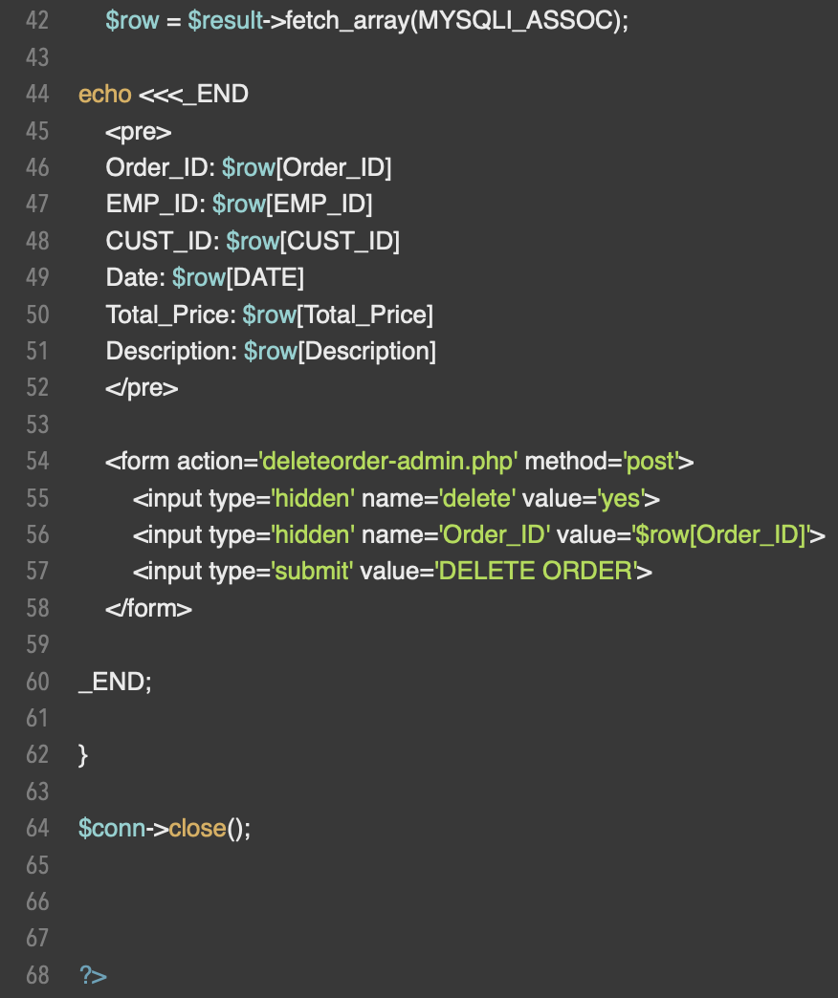
View/Add/Update/Delete Orders Code

Slide 14
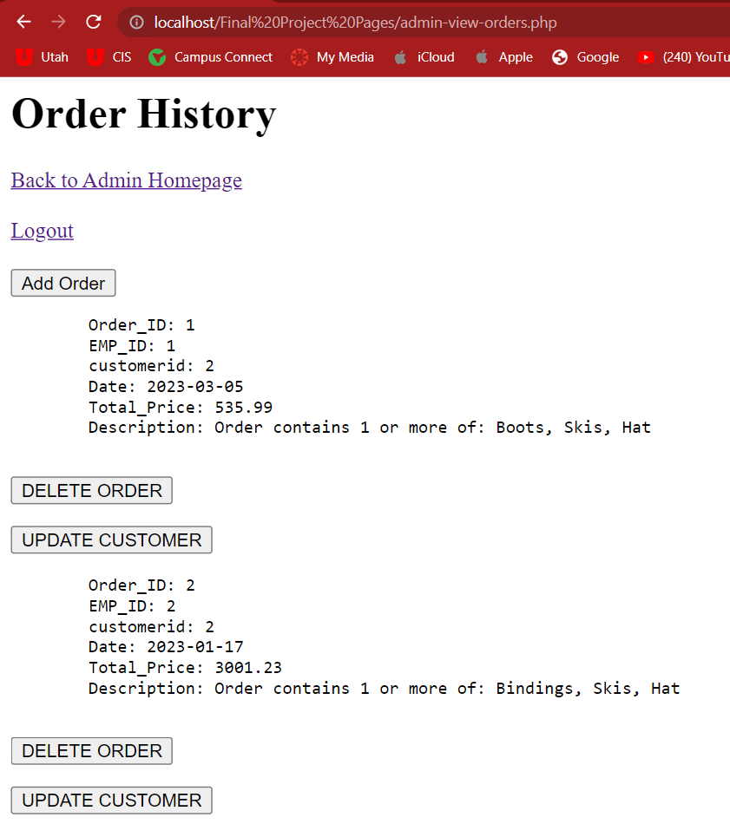
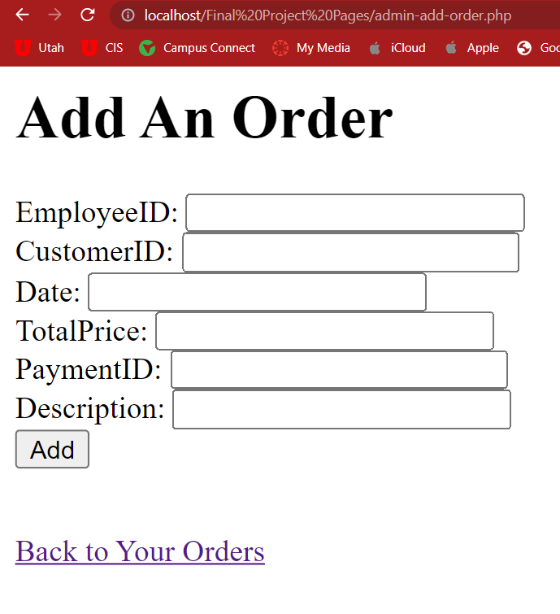
View/Add/Update/Delete Orders Website

Slide 15
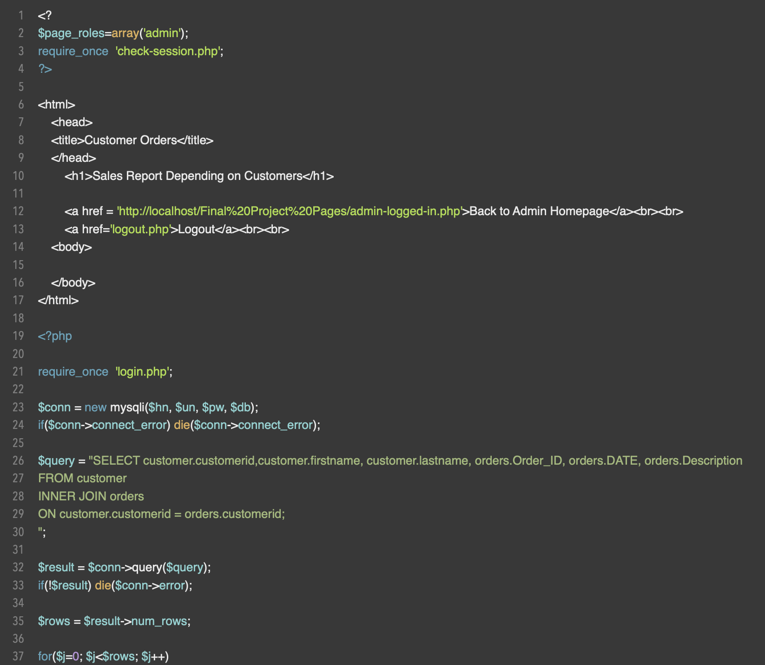
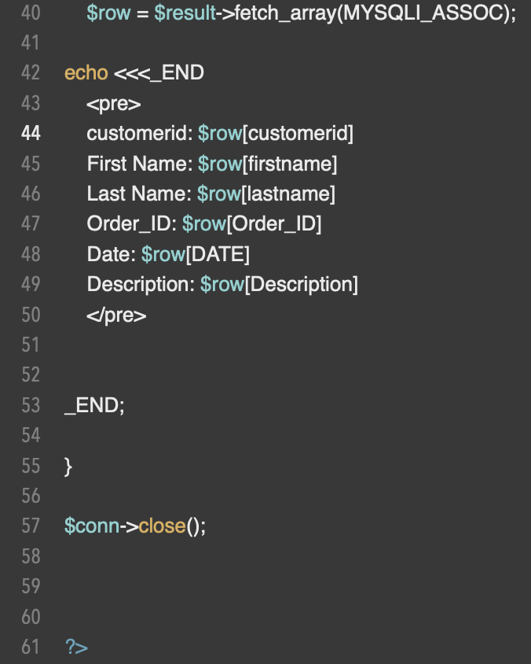
Generate Sales Report Code

Slide 16
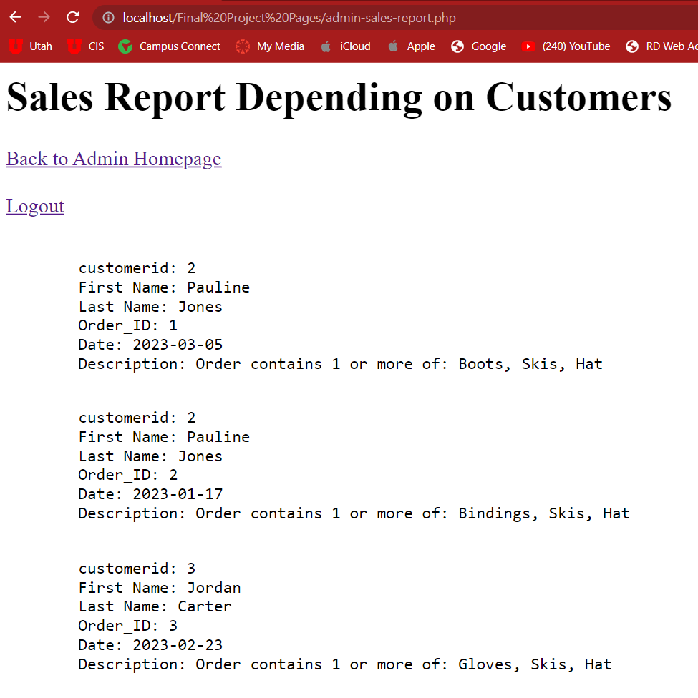
Generate Sales Report Website

Slide 17
Challenges
We saw major challenges trying to get our update coding to work, as well as with creating a shopping cart for our customers use.
We saw more minor challenges with syntax errors, cross-coding, meaning working on Mac and Windows computers and trying to share code, and with creating too high expectations of what we could get done in the time we had.

